Slide 1


Human aspects of Cyber Security

Slide 2

Session Outline
Social Engineering, Awareness & Culture:
Human factor in cyber security
Social engineering techniques
Security policy
Security culture

Slide 3

The human aspect
The human aspect of Cyber Security refers to roles that individuals play in relation to the security of information systems.
It includes the individual awareness level of different cyber security threat vectors; the behaviours of those individuals based on that awareness and the practices and policies that an organization uses to limit risks.
Notes:
Individuals, whether as students or employees can be both defenders and targets in the cyber threat landscape, which is why it is important for organizations to analyse and understand this human aspect of cyber security.
Important factors of the human element can include:
User awareness and education – specific training to help individuals recognize and respond to cyber threats.
Password practices – ensuring that users use and maintain suitable passwords and are responsible with them.
Human error – Mistakes users make such as clicking malicious links in emails or disclosing sensitive information.
Insider threats – The term for individuals within an organization that either intentionally or unintentionally cause security breaches.
Social engineering – the specific behaviour of threat actors to take advantage of these human elements.

Slide 4

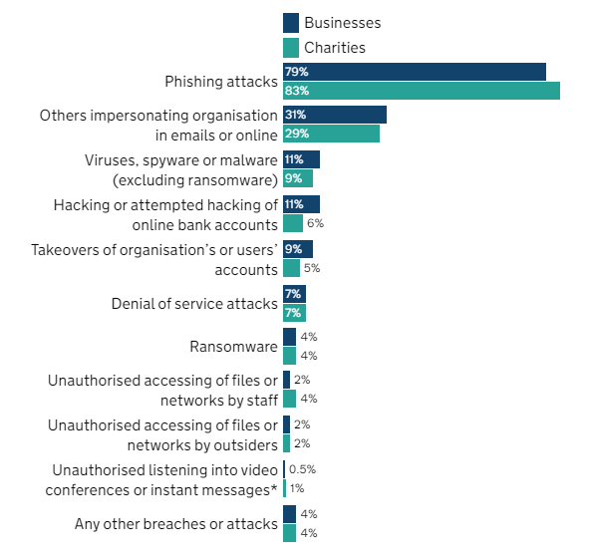
Cyber Security breaches
According to the UK Cyber Security Breaches Survey 2023, over the past year:
32% of businesses experienced a form of cyber attack breach.
24% of charities experienced a form of cyber security breach.
Most breaches were caused by various forms of social engineering.
Source: https://www.gov.uk/government/statistics/cyber-security-breaches-survey-2023/cyber-security-breaches-survey-2023
Notes:
Within the UK, the government publishes an annual report known as the Cyber Security breaches survey. The report provides important insight into the cyber threat landscape within the country and assesses the prevalence and impact of cybersecurity attacks and breaches.
It plays a crucial role in shaping the understanding of cybersecurity challenges faced by organizations across different sectors. It helps inform government policies, encourages best practices, and facilitates collaborative efforts to strengthen the overall cybersecurity posture of the UK. Organizations can use the survey findings to benchmark their cybersecurity practices against industry trends and make informed decisions to enhance their resilience against cyber threats.
The survey typically breaks down information between businesses and charities, where there will be reasonable organizational differences in approaches to information technology.

Slide 5

Social engineering
Social engineering is a technique used by cyber criminals to target the human aspect of an organization’s security infrastructure.
Rather than targeting technical vulnerabilities, criminals using social engineering seek to manipulate individuals into sharing confidential information, downloading or installing malicious software or sending money to criminals.
Social engineering uses psychological manipulation to exploit human error or weakness rather than engaging in a cyber attack. This often results in cyber criminals obtaining credentials.
Source: https://www.ibm.com/topics/social-engineering

Slide 6

Blagging
Blagging is a process of social engineering where the threat actor presents the victim with a false narrative to draw them into engaging with the threat actor.
The goal of the false narrative is to convince the victim that the threat actor might be someone they know and that they need something from the victim.
E.g., You receive an email from someone pretending to be your friend, asking you to send them money in an emergency.

Slide 7

Phishing
May contain malware hidden in an email attachment.
May present the user with information about them and ask them to confirm additional details.
May trick the user into entering their login details for a specific service into a fraudulent website.
May offer the user something that appears to be valuable in exchange for providing information.
Notes:
Phishing presents the victim with a false narrative where the communication appears to be from a legitimate business or entity.
A phishing email may also appear to be visually similar to a legitimate email from a bank.
The email might suggest that the victim needs to access their online banking account via a URL in the email to update their personal details or risk losing access to their money.
When accessing the URL contained within the phishing email, the victim might be taken to a website that appears virtually identical to their online banking portal – but is in fact a clone of the legitimate website owned by the threat actor.
When the victim enters their online banking credentials into the fake portal, the threat actor obtains these credentials and can now access the victims legitimate bank account.

Slide 8
Spear Phishing
Targets a specific individual within an organization where the threat actor has carried out research about the target victim.
Asking for specific information or urgent financial transaction.
Providing a fake invoice that the victim pays.
Fraudulent job offers that lure the victim into providing information.
Luring the user into entering credentials to prevent the ‘deactivation’ of their computing account.
Fake invitation or registration email that lures the user into entering their details onto a website.
Notes:
Spear phishing is a specific form of phishing where the threat actor has undertaken a considerable amount of research about the target organization and potential target victims within that organization.
The threat actor prevents a false narrative with the goal of obtaining specific information or finance from specific targeted individuals within an organization.
A threat actor may target the personal assistant of a senior member of staff for example, whilst impersonating their employer.

Slide 9


Pharming
The victim may have previously installed malicious software (such as from an email attachment) that ensures when they try to visit a specific legitimate website, they are presented with the fake malicious version.
The victim is likely to be unaware of the redirection and believe the malicious website to be the legitimate one.
Notes:
Similar to the example of phishing involving the cloned online banking website, pharming is a specific from of social engineering where the victim is redirected from a genuine website to a malicious website.
This is likely to occur in situations where the victim needs to provide login credentials. The threat actor may be seeking to capture login credentials for a specific organization or service.
In employment settings, the threat actor might be attempting to capture sensitive credentials that would enable them to access and exfiltrate data of considerable value.

Slide 10

Vishing (voice phishing) & Smishing
Telephone call that tries to convince the user their computer is infected with a virus.
Caller may convince the user to allow remote access to their computer.
Text message appearing to be from a relative, perhaps claiming to have changed their phone number.
Notes:
Like blagging and phishing, voice phishing occurs when the threat actor makes a telephone call to the victim and uses false pretences to gain the trust of the victim.
The caller might, for example, pretend to be from a company like Microsoft and suggest that they require remote access to the victims computer to resolve a software problem.

Slide 11

Shouldering (shoulder surfing)
Shoulder surfing occurs where the threat actor eavesdrops over the victim to observe the input of sensitive credentials or information.
Being watched entering a password for a service or system.
Being watched entering a keypad code for a physical door lock.
Being watched entering your pin number when withdrawing money from a bank.
Being watched entering your pin number when purchasing something.
Notes:
This could happen in a workplace where one colleague has access to more sensitive information than another.

Slide 12

Activity: Social engineering
Let’s test our knowledge of social engineering and see if we can identify some examples of communications that might be from a threat actor.

Slide 13


Information security policy
Updates - Keep computers and devices up to date with the latest software patches and updates.
Information classification – based on sensitivity and value of a given document or set of document.
Bring your own device – specific guidance on using your own laptop or device at work.
Unacceptable use – examples of things that individuals must not use computer systems for. E.g., Bullying & harassment or digital piracy.
Notes:
As one of the measures to protect against social engineering, most organizations have robust information security policies.
This is a set of documented guidelines and practices that informs how an organization manages its information assets and infrastructure.
A strong information security policy should clearly outline its objectives, scope as well as roles and responsibilities.
Here are some examples of common things you might find in a robust security policy.

Slide 14

Activity: School security policy
Have a look at the School security policy, have you read it before?
How many of you have read the terms and conditions when you’ve signed up for a website or downloaded a new app for your phone?

Slide 15

Cyber Essentials policy requirements
The Government backed Cyber Essentials scheme in the UK outlines that a strong information security policy must include:
IT Security policies (e.g., password requirements).
Data protection policies (e.g., handling of data).
Bring your own device policy (rules for using your own laptop at work).
Acceptable use policy (expectations for users).
Privileged user policy (ensuring sensitive resources require clearance).
Notes:
Within the UK, Cyber Essentials is a government sponsored scheme that enables organizations to obtain certification in recognition of adhering to set standards of protecting themselves from common cyber security threats.
The certification helps organizations to establish a baseline of cyber security practices and processes to help mitigate the risk of cyberattacks and security breaches.
Cyber Essentials is managed by the National Cyber Security Centre (NCSC) and organizations that want to secure sensitive and valuable contracts often need to have obtained this certification.

Slide 16
Activity: Poster design
Let’s test our knowledge of social engineering and see if we can identify an example of an attack versus a legitimate communication.

Slide 17
Discussion: Security scenarios
Credential sharing
Email communications
Digital piracy
Shoulder surfing
Tailgating
Notes:
Credential sharing:
Individuals sharing login credentials for streaming platforms (e.g., Disney+, Netflix or AppleTV) with friends or family members who do not have their own subscription.
Students or educators sharing login credentials for educational resources like libraries or research databases.
Sharing of workplace account details amongst individuals that are not authorized to access specific systems.
2) Email communications:
Email from your boss that explains they urgently need you to purchase digital gift vouchers and send them the codes – they will reimburse you later.
3) Digital piracy:
Software piracy – Illegally distributing or downloading software (e.g., video games) without the proper software license. (Risk of malware in downloaded software).
Movie piracy – Illegally downloading or streaming movies through risky websites or peer-to-peer networks. (Risk of malware on illegal streaming websites – popups).
4) Shoulder surfing:
An individual watches you (perhaps using a camera) enter your pin number at an ATM machine – the ATM machine might have a device called a skimmer attached to it which has taken your card details but the threat actor still needs your pin number.
Someone watches you enter the login credentials for something they don’t have access to and intends to use your credentials to access it for themselves.
5) Tailgating:
You need a pin code or card to enter a building and either someone follows you in or you allow someone through. (What if they claim they’re waiting for someone or forgot their own pin/card?)

Slide 18

Any Questions?
Thank You

